Slide 1
Introduction to Cloud Computing Unit 3- Day4 S/W dev in cloud – part2
Prashant Kaushal

Slide 2
Recap
S/W development for the cloud is different

Slide 3
SaaS challenges
the development of SaaS application imposes a lot of challenges
With the traditional development environment, it is very difficult to develop a successful SaaS that satisfies all the SaaS-specific requirements.
To overcome these challenges, SaaS development companies can use the popular PaaS that provides many SaaS specific features by default.
By using PaaS, the developers can concentrate more on application functionalities rather than struggle with enabling SaaS-specific features.

Slide 4
S/W dev using PaaS
PaaS enables the developers to develop an application online
development platform on demand basis.
need not install any heavyweight software in their machine to use PaaS.
The developers can develop and deploy an application online through the client tools such as web UI, Command Line Interface, web CLI, and REST API provided by the service provider.

Slide 5
Benefits
• PaaS provides the services to develop, test, deploy, host, and maintain applications in one place. • Most of the service providers offer polyglot PaaS where the developers can use a variety of application development environments in one integrated development environment (IDE).
• The variety of client tools such as web UI, web CLI, REST APIs, and IDE integration increases the ease of application development and deployment. • PaaS offers a built-in multitenant architecture for the applications developed using PaaS. • PaaS provides a software load balancer that ensures the dynamic scaling of the application. • The replicas maintained by PaaS providers ensure the high availability of the application. • PaaS providers also allow integrating with other web or cloud services to develop composite cloud services. • PaaS increases the collaboration between the development team as the application will be deployed at a central place. • The other important SaaS-specific features like monitoring tools and automated billing will be offered by PaaS itself.

Slide 6
PaaS : Before and After
changes the software development process totally when compared to the traditional software development model.
Traditional
requirements analysis
design phase (software architecture, UI, and db design)
implementation phase
Heavy weight dev environment needed
Testing
security, scalability, availability, and portability
Deployment
Maintenance
scalability and availability

Slide 7
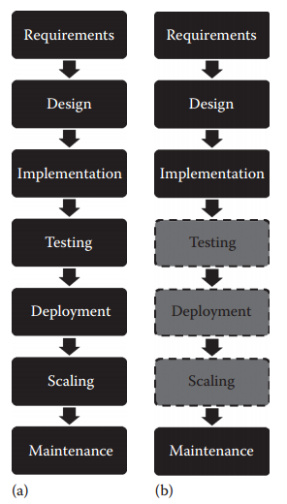
a)Before b)After

Slide 8
Requirements Analysis
The development team should cope up with frequently changing requirements of the SaaS application.
The requirement document should include functional, nonfunctional, and other SaaS-specific requirements.
Before developing the application, the requirements collection team should analyze the suitability of the SaaS delivery model for the customers’ requirements.
Security experts should ensure the security at all layers of the application.
The software architect should ensure the scalability and availability of the application.

Slide 9
Multitenant Architecture
multiple customers are allowed to share the same application
depends on the software architecture.
can be achieved at the infrastructure, development platform, database, and application levels
If the software architect selects an IaaS provider for the infrastructure needs, then the architect is relieved from enabling multitenancy at the infrastructure level.
If the architect chooses the PaaS provider, the platform level and the infrastructure level multitenancy will be provided by the PaaS provider itself.
So, the software architect’s job gets reduced to enable the multitenancy features only at the software level.
The security threat to data will increase as the multitenancy level increases.
If the company wants high resource utilization, they can go for a high-level multitenancy.

Slide 10
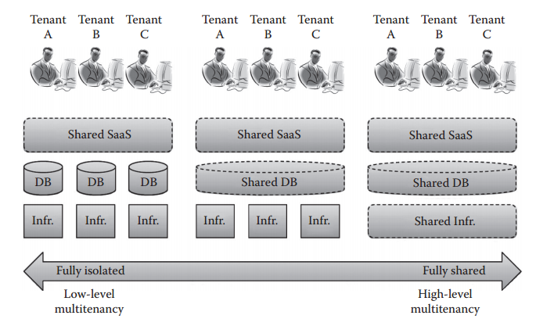
Multitenant Architecture

Slide 11
Highly Scalable and Available Architecture
dynamic scaling
depends on the software architecture.
As the load on the SaaS application becomes unpredictable and increases or decreases any time, the architecture should ensure the same performance on varying loads
The scalability of the SaaS application can be achieved using horizontal scaling, vertical scaling, software load balancer, and hardware load balancer.

Slide 12
Highly Scalable and Available Architecture
In horizontal scaling, identical resources (application server, database server, and infrastructure) will be added to the application to handle the additional load.
In vertical scaling, the capacity of the server (application, database, and infrastructure) will be increased as the load increases.
The role of the software load balancer is to distribute additional user request across different application and database servers.
The hardware load balancer will distribute the load across different virtual machines when there is a need for more computing power

Slide 13
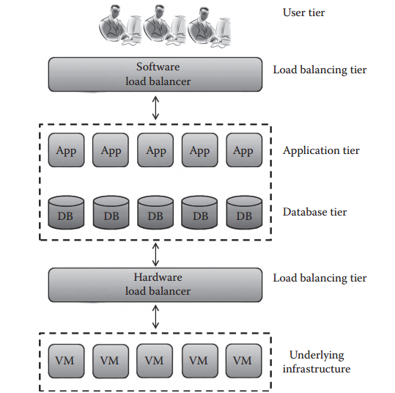
Highly Scalable and Available Architecture

Slide 14
Availability
The availability of the application decides its uptime and downtime.
The availability of the application is an important parameter of the SLA.
Ensuring the 99.99% availability of the application depends on the replica mechanism that is specified in the software architecture.
multiple copies of virtual machines and database applications should be maintained for high availability.
While maintaining the replica, another important aspect is recovery time after any failure.
The application should be fault tolerant, and the recovery time should be minimal to avoid SLA violation.
The replica should be maintained near the customer location to reduce the recovery time after any failure or disaster.

Slide 15
Database Design
Achieving multitenancy, scalability, and availability at the database level is an important criterion for successful SaaS development.
The database design for multitenancy should consider the security requirement of the data.
Multitenancy at database level can be achieved by sharing the database instance, sharing the database table, and sharing the database schema.
Depending on the security of the application, the database should be designed to secure multitenancy.
The database-level multitenancy can be achieved in three different ways
If the database designer selects a separate database for different tenants the security will be ensured.
If the shared database and separate schema are selected, the security to the data will be moderated

Slide 16
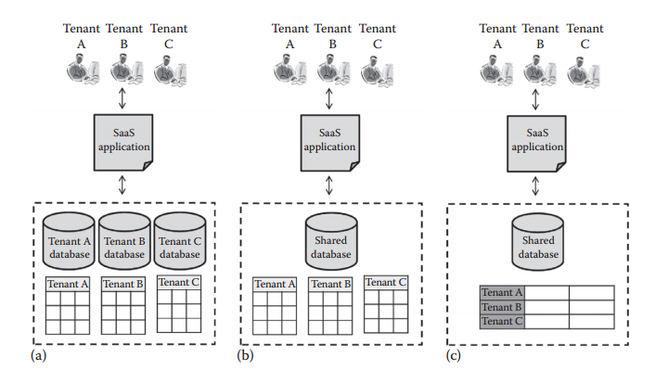
Database Design

Slide 17
Database Design
The scalability and availability of the database decide the performance of the application.
Most of the SaaS applications are interactive and involve a large number of database of read and write requests from the users.
When the number of requests exceeds the actual capacity of the database server, additional requests should be redirected to the other server.
When requests are redirected, a change of data in one database server should reflect in other database servers also.
Mostly the type of data used in the SaaS application will be diverse and includes structured, semistructured, and unstructured data in huge amounts.
So, for SaaS applications, Not Only Structured Query Language (NoSQL) databases will be a better option than traditional relational, object-oriented databases.
The developers can leverage the advantages of NoSQL databases to achieve scalability and availability at the database level in an efficient way.

Slide 18
SaaS Development
The PaaS tools allow the developers to develop the application online, and the application will be deployed on the service provider infrastructure as soon as the developer pushes the application online.
Here, the end users or SaaS consumers can access the application online using the web UI provided by the SaaS provider.
The PaaS providers also provide testing tools in the same development environment to facilitate the developers.
While developing the application, the developers should incorporate the following things for successful SaaS: • Responsive UI design to support multiple devices • Role Based Access Control (RBAC), Access Control List (ACL) mechanism to uniquely identify users and tenants • Monitoring tools that will monitor the performance and notify the service provider frequently • Control panel for the tenant and admin to manage the users • User-centric customization panel that does not affect the settings of other tenants or users • Self-service sign-up for the users
• Usage statistics and bill calculation • Help documentation to use the service • Service integration

Slide 19
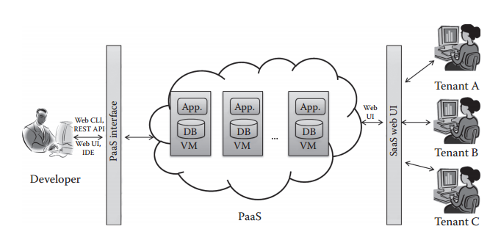
SaaS Development

Slide 20
Monitoring and SLA Maintenance
After delivering the application, any misbehavior, failure, security attacks, and disasters of SaaS applications should be monitored and prevented.
Since a lot of customers are sharing the same instance of a single application, any misbehavior from one tenant will affect the other tenants and the underlying resources.
Updates should be scheduled and performed in such a way that it does not affect the normal behavior of the system, so updating the SaaS application frequently will offer the its most updated version to the end users.
But if the application is updated with bulk updates frequently, it may lead to the unavailability of the application.
Another important job in SaaS monitoring is to monitor the SLA violation by both the service provider and customer.
If there is any SLA violation, the monitoring tool should notify the developers to correct the errors that lead to the SLA violation.
The SaaS providers should define the SLA clearly to the end users before delivering any services.
The SLA should include the availability, response time, and degree of support.
The service providers also should provide 24 × 7 support to the end users.
The development team should resolve the issues frequently as soon as feedback is received from the end users.
There are many third-party monitoring tools are available to monitor SaaS applications.

Slide 21
Thanks

